Slide 1




T2T Research nurse training

Slide 2

Study team – Introduction
Dr Edward Roddy –Keele Co-investigator
Prof Christian Mallen - Keele Co-investigator
Emily Hughes – Trial Manager
Stephanie Butler-Walley- Trial Manager
Sarah Bathers– Senior Trial Manager
Claire Bratt Lead Admin Support
Dr Abhishek Abhishek– Chief Investigator
Professor Michael Doherty – Nottingham Co-investigator
Dr Miriam Santer – Southampton Co-investigator
Professor Paul Little –
Southampton Co-investigator

Slide 3

Background
Gout affects 2.5% adults in the UK.₁
It results from sustained hyperuricemia, which causes intra- and peri-articular monosodium urate crystal deposition. When these crystals are released, they induce intense inflammation, which manifests as a flare of gout.
Sufficient evidence that high serum urate is associated with gout, and with frequent gout flares.₂
In the UK, gout is managed predominantly in primary care by general practitioners (GPs), but less than half of patients receive urate-lowering therapy.₃
The dose is usually fixed without titration to achieve a target serum urate concentration. ₄

Slide 4
Background
  Nottingham RCT: https://www.thelancet.com/journals/lancet/article/PIIS0140-6736(18)32158-5/fulltext
  Whether such care is generalizable and could be equally well delivered by non-research practice-based nurses, or other health professionals, is unknown.
  Remains unknown if an allopurinol based treat-to-target ULT regime that includes flare prophylaxis, reduces the number of gout flares from treatment initiation.
  This lack of clarity has resulted in sub-optimal gout management and culminated in discordant recommendations from primary care and rheumatology gout treatment guidelines

Slide 5
The current study
The proposed study builds on our experience of delivering a nurse-led package of care for gout that included treat-to-target ULT in a single centre trial, to a multicentre primary care based study, with inclusion of flare prophylaxis, and flares in the first two years.
To determine the clinical and cost-effectiveness of allopurinol based treat-to-target ULT in people with recurrent gout flares compared to usual GP care.
randomised controlled trial and internal pilot study.
Internal pilot: To assess consent rate, attrition, quality of outcome data, delivery of treat-to-target urate-lowering treatment (ULT) and preliminary estimate of the effect of the intervention.
90 patients followed up for 1 year before progression to main trial is confirmed and a further 376 patients recruited. (Autumn 2020).

Slide 6
Study recruitment
Usual GP Care – patient advised to consult GP for gout flares as usual
Primary outcome data- collected by reporting flares via SMS or paper diary – number of gout flares over 2 years. Patient followed up by CRN research nurse at 1 and 2 years post randomisation.
Medical record review at 4 years post
randomisation
Practice list search & screening questionnaire
Screening visit with CRN research nurse, to check patient eligible from serum urate and eGFR
Baseline assessment and randomisation visit (face to face or telephone) with CRN research nurse following blood results
Treat to Target Urate lowering therapy with practice nurse/primary care clinician
In order to recruit participants who may not have consulted their local GP about gout, we will, - Put up study posters in participating GP surgeries and local pharmacies and advertise the study in local newspapers.

Slide 7
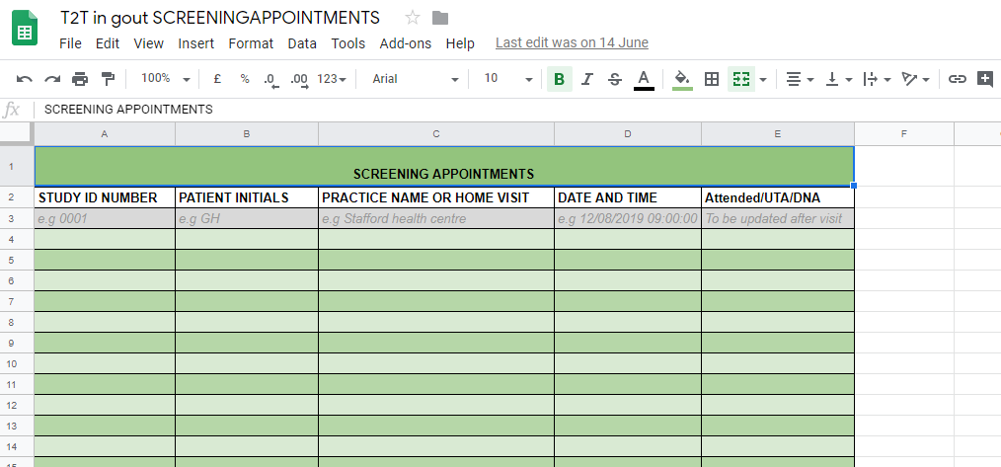
Study recruitment
  Keele CTU will assess eligibility based on questionnaire responses.
  Details of potentially eligible participants will be sent via NHS.net to research nurse/researcher in the relevant region.
  Research nurse will contact patients via telephone using CRF07 – pre eligibility screen to ask them the screening questions. Return to Keele CTU.
  Non-eligible patients will be thanked and advised to attend their GP practice for gout flares as usual
  If you are unable to make contact with a patient please record on the contact log and return to Keele CTU and we will send them a letter.
  Research nurse/researcher will arrange for the potential participants to be invited for a screening visit at their GP surgery based on pre-determined availability of rooms at the practice.
  Screening visits can also be arranged at the participants’ own homes if they are unable to attend the GP surgery due to other commitments, e.g. due to work.
  Once appointment confirmed with patient, Study ID number and patient initials and date and time of appointment entered on to share point spreadsheet.
  Example:
  https://keeleacuk.sharepoint.com/:x:/r/sites/FMHS-T2T/Shared%20Documents/General/T2T%20in%20gout%20SCREENING%20%26%20BASELINE%20APPOINTMENTS%20%20(1).xlsx?d=wc19c050382b64fc68ee053e12b02e708&csf=1&web=1&e=TCxEoF

Slide 8
Screening visits
Research nurse/researcher to try to arrange screening appointments close together at each practice to save resource and travel.
Research nurse/researcher to keep track of appointments that have been arranged and to attend as necessary.
As serum urate can reduce during a gout flare, care will be taken to schedule screening visits at least 2 weeks after self-reported resolution of the gout flare.
If patient informs that they are unable to attend, please record on share point spreadsheet.
If a patient informs Keele CTU that they are unable to attend, this will be recorded on the spreadsheet and researcher/research nurse will be notified via telephone or email.
Please try to re-arrange appointments with patients that UTA or DNA by contacting them by telephone.

Slide 9
Screening visits
Contact log to be completed each time contact is made with the patient.
Patients that DNA on the day and unable to contact via telephone, please record on share point spreadsheet and they will be sent a letter from Keele CTU, asking to contact us if they still wish to take part.
The aim of the screening appointment is to take informed consent, further assess eligibility and to take blood for serum urate and creatinine for eGFR.

Slide 10
 | Screening | Baseline | Treatment | Treatment | Treatment | Treatment | Treatment | Treatment | Treatment | Res. Yr. 1 | Res. Yr. 2 | Final visit
Week | 0 | 1 | 5 | 9 | 13 | 17 | 21 | 25 | 29 | 52 | 104 | 208
Informed Consent | X
Inclusion / Exclusion | X
Research questionnaires¹ |  | X |  |  |  |  |  |  |  | X | X
BMI, BP, tophus count/size |  | X |  |  |  |  |  |  |  | X | X
Blood collection | X^{2,3} |  | X² | X^{2,4} | X^{2,4} | X^{2,4} | X^{2,4} | X^{2,4} | X^{2,4} | X^{2,3} | X^{2,3}
Urine collection |  | X⁵ |  |  |  |  |  |  |  | X⁵ | X⁵
Randomize |  | X
Gout flare and healthcare utilization diary⁶ given⁷ |  | X
Start T2T-ULT/dose change |  | X | X | X | X | X | X | X | X | X
Gout flare SMS data collection
Unused medication return |  |  |  |  |  |  |  |  |  | X | X | X
Flare & healthcare use diary collect |  |  | X | X | X | X | X | X | X | X | X
Data collection from GP records |  |  |  |  |  |  |  |  |  | X | X | X

Slide 11
Informed consent
Introduce the T2T study
Check that the patient has read the current version of the Patient Information Sheet (PIS)
Go through the study and what taking part will mean for the patient
Does the patient have any questions?
Agreement to proceed
Be transparent and consistent
throughout the process

Slide 12
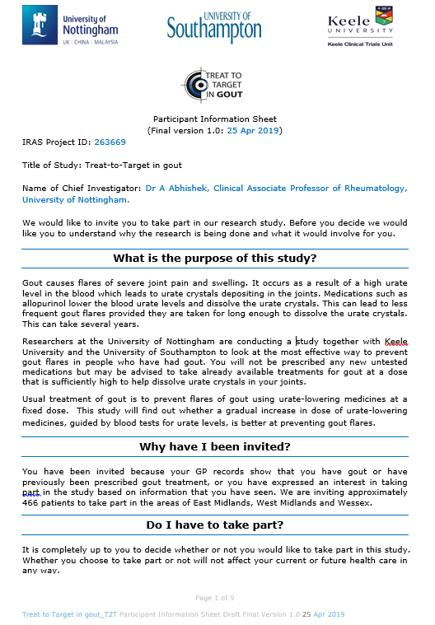
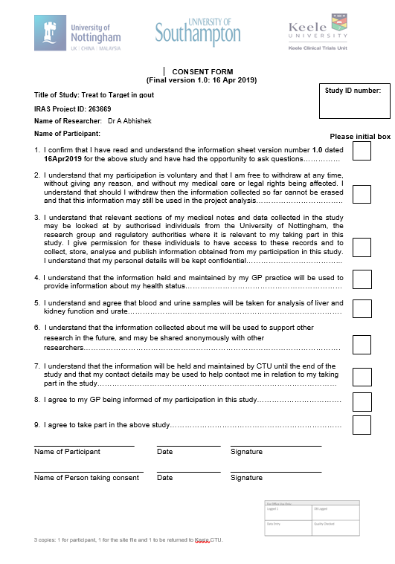
Informed consent
Read each item on the consent form individually
Add additional explanation if required to aid understanding
If the potential trial participant is happy with each statement ask the patient to initial the box
Both sign and date the consent form
The consent form will be carbon copied. The original should be placed in the site file, a copy given to the participant and a copy returned to Keele CTU via freepost envelope in the research nurse pack.

Slide 13
Eligibility assessment
Complete paper CRF01 – Eligibility assessment form with patient present.
Inclusion criteria:
  Age ≥18 years,
  Ability to give informed consent,
  Meets the clinical American College of Rheumatology (ACR)/European League Against Rheumatism (EULAR) classification criteria for gout
  ≥1 flare of gout in the previous 12 months, and
  Serum urate ≥360 μmol/L regardless of current ULT
  Exclusion criteria:
  Dementia, severe enduring mental illness i.e. mental health illness that makes receiving the study information and initial screening questionnaire from GP a stressful experience,
  Unable to comply with study procedures,
  Life expectancy less than 12 months,
  Cancer treatment, i.e. surgery, radiotherapy, or chemotherapy in the previous 12 months,
  Solid organ transplant,
  Cirrhosis,
  Autoimmune rheumatic disease i.e. rheumatoid arthritis, psoriatic arthritis, systemic lupus erythematosus, connective tissue diseases, vasculitis, giant cell arteritis, polymyalgia rheumatica, inflammatory arthritis associated with inflammatory bowel disease, reactive arthritis, ankylosing spondylitis,
  Inflammatory bowel disease
  Current long-term daily oral corticosteroid treatment defined as continuous use for ≥30 days or current immunosuppressive treatments,
  Stage 4/5 CKD i.e. eGFR < 30 ml/min,
  Pregnant, breast feeding or planning to become pregnant in the next 4 years.

Slide 14
Meets the clinical American College of Rheumatology (ACR)/European League Against Rheumatism (EULAR) classification criteria for gout
Patient given a score based on a number of set criteria. A score of 8 or more indicates a diagnosis of gout and thus the patient is eligible, a score below 8 the patient is not eligible.
-CRF01 completed, using relevant questions with the patient.
- Must be updated following blood results and sent back to Keele CTU.

Slide 15
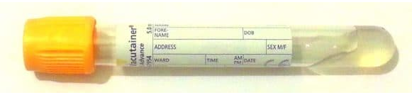
Serum urate ≥360 μmol/L regardless of current ULT
Also part of the ACR/EULAR classification criteria.
Participant should have serum urate level above or equal to 360 μmol/L
Take blood for U&E (creatinine) and Urate using yellow top blood tube as per standard process, equipment will be available in the room at the GP practice. If you are visiting a patient home, please take a request card for the patient to get the test done at a local phlebotomy clinic or their GP practice, available from the Trial Manager.
Include all patient details on the tube and on the request form including a request for U&E and Urate analysis.
If you are unable to take the patients blood at the time of the screening visit, please give a completed biochemistry request form to the patient and ask them to attend their local phlebotomy clinic or GP practice for blood test as soon as possible
Blood results should be followed up 1-2 days later by attending the GP practice or asking the practice for the blood results over the phone. CRF01 should be updated when the results are received and returned as soon as possible to Keele CTU (scanned version initially (via NHS.net) followed up with posted original is fine), If the patient does not meet the eligibility criteria based upon blood results please call the patient to inform of their blood results, inform them they are ineligible to take part and to consult their GP for gout flares as usual. If unable to contact please inform the TM via NHS.net or complete a contact log and return to Keele CTU.

Slide 16
Stage 4/5 CKD i.e. eGFR < 30 ml/min
As above with serum creatinine. Once creatinine results received:
If eGFR is less than 30 ml/min patient is ineligible.
CRF01 should be updated accordingly

Slide 17
Screening visit paperwork
Once blood results have been received and documented on the CRF Please tear off the original version of CRF01 (Page 1,2 and 3)
Scan the completed CRF01 and send via NHS.net
Please follow up with the original copy to Keele CTU via post using freepost envelopes.

Slide 18
Baseline visits
Tophus count: The participant should have head and face, arms and legs exposed from shoulder to hands, and mid-thigh to feet. Look for whitish-yellow firm to hard lumps across the exposed areas. Tophi are common on the ears, tip of the elbow, hands and wrists, knees, ankles and feet.
Tophus measurement: The largest tophus at examination should be considered the target tophus for evaluation of size. The largest diameter of the target tophus should be measured with a 150 mm Vernier caliper calibrated in millimeters. Soft collections at olecranon bursa (elbow) with urate milk should be excluded as target tophi because local inflammation with synovial effusion may contribute to enlargement of the mass. The borders of the longest diameter should be marked by pen, and the diameter recorded.
Arthritis Rheum. 2002 Aug;47(4):356-60.

Slide 19
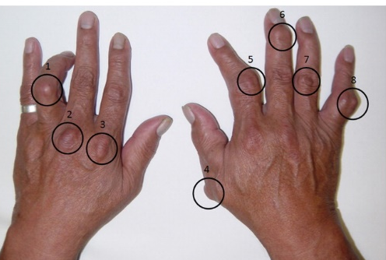

Counting total number of subcutaneous tophi
Vernier callipers for measurement of the longest tophus diameter
All palpable subcutaneous tophi over the entire body are counted. Figure shows counting for dorsum of hands.
Left panel: marking of the borders of the tophus in the longest plane.
Right panel: measurement of the longest tophus diameter using digital 150 mm Vernier callipers.
Annals of the Rheumatic Diseases 2011;70:597-604.

Slide 20
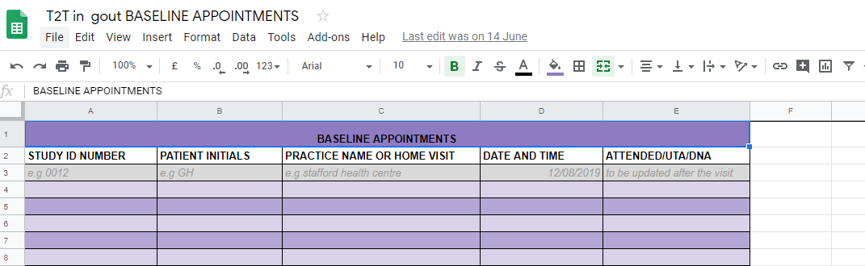
Arranging the baseline visit
You can provisionally book the patient baseline visit at the screening visit pending outcome of blood results.
Advise patient to attend unless you call them to inform them that they are ineligible to take part.
Baseline visit preferences
If you have not booked the baseline visit at the screening appointment; following blood results and confirmation of eligibility, please call the patient to invite them to a baseline appointment within 2 weeks of their screening visit.
Follow the same process for recording patient baseline appointments on share point spreadsheet.
Same process for recording UTA/DNAs
https://keeleacuk.sharepoint.com/:x:/r/sites/FMHS-T2T/Shared%20Documents/General/T2T%20in%20gout%20SCREENING%20%26%20BASELINE%20APPOINTMENTS%20%20(1).xlsx?d=wc19c050382b64fc68ee053e12b02e708&csf=1&web=1&e=TCxEoF

Slide 21
Baseline visits
The purpose of the baseline visit is to collect baseline research data, confirm eligibility following blood results and to randomise the participant.
 | BASELINE
Week | 1
Research questionnaires¹ | X
BMI, BP, tophus count/size | X
Urine collection | X⁵
Randomize | X
Gout flare and healthcare utilization diary⁶ given⁷ | X
Start T2T-ULT/dose change | X

Slide 22
Baseline visits
Urine collection for albumin-creatinine ratio in a white top universal container.
Ask patient to provide a urine sample and send of for processing as per local GP practice process.
If telephone visit remind the patient to drop off their urine sample
Confirm receipt of Baseline questionnaire with Keele CTU ahead of visit
Height and weight measured and recorded.
Blood pressure checked and recorded. (if out of range- ask patient to consult their GP)- if baseline is a telephone visit this will be recorded at screening.
CRF02 should be completed.

Slide 23
Gout flare data collection
A mobile phone text-messaging system will be used to collect data on occurrence and severity of gout flares.
When the participant is experiencing a gout flare, they will be asked to text the word gout on the first day of that flare to a number provided by Keele CTU. They can still text “gout” at a later date.
The messaging system will send short text messages enquiring about pain severity (0–10 numerical rating scale) over 7 days including presence of warm joint, and swollen joint. This will be used to classify self-reported gout flares as meeting the criteria for a flare of gout.
Patients sent reminder text every 2 months
During a flare as well as using the text-messaging system patient will be asked to complete a paper gout flare diary which includes EQ5D and healthcare utilisation.

Slide 24
Gout flare data collection
Patients who do not wish to complete text message data collection on flares will be given the option to complete a paper diary during a flare with an envelope to return it to Keele CTU. This will contain the pain scores as well as EQ-5D and healthcare utilisation.
Patients will need to be given their diaries at the baseline visit and given a reminder of when to complete them
Wallet card insert as reminder

Slide 25
Online Gout flare diary Collection
Patients may also choose to report their gout flare online.
This should be indicated on CRF02.
Keele CTU will then provide the patient with access to the online diary and a unique token.
If selecting online option please confirm the patients email address at the point of randomisation with Keele CTU.
Inform the patient they will be emailed the access information.

Slide 26
Randomisation
Once all the screening and baseline procedures have been completed, you can proceed to randomise the patient by calling Keele CTU on 01782732950, where an administrator will ask for some information and proceed to randomise the patient using the online system.
During the visit the patient will need to be asked if they have experienced any side effect to Colchicine previously. You will need to inform the administrator over the telephone that the patient should be randomised as being intolerant to Colchicine.
Once the patient has been randomised, the administrator will inform you of the patients allocation over the telephone. An email will also be sent to you confirming the patients randomisation allocation.

Slide 27
Previous colchicine intolerance
Ask participants if they have ever taken colchicine tablets for gout flares?
If so, did they experience side-effects such as diarrhoea? Or any other side-effects?
If yes, record the fact that they got side-effects to colchicine [there is no need to record the actual side-effect].

Slide 28
Randomisation
Patients will be randomised to one of two arms:
Usual GP care: Advise the participant to contact their GP regarding gout flares as usual and remind them that they will be followed up as research participants in year 1 and year 2 and should still provide data on flares.
Treat to Target ULT- Refer participant to see practice nurse to be started on 100mg of allopurinol or dose increase unless contraindicated. Book the patient in for an appointment with the practice nurse as soon as possible or the trial manager will contact the practice nurse to arrange the appointment. Please let the TM know of the outcome.

Slide 29
Baseline paperwork
At the end of the visit:
Please return the original baseline questionnaire and CRF to Keele CTU in freepost envelopes provided.
Tear the original CRF02 (Pages 1-3) and return to Keele CTU.

Slide 30
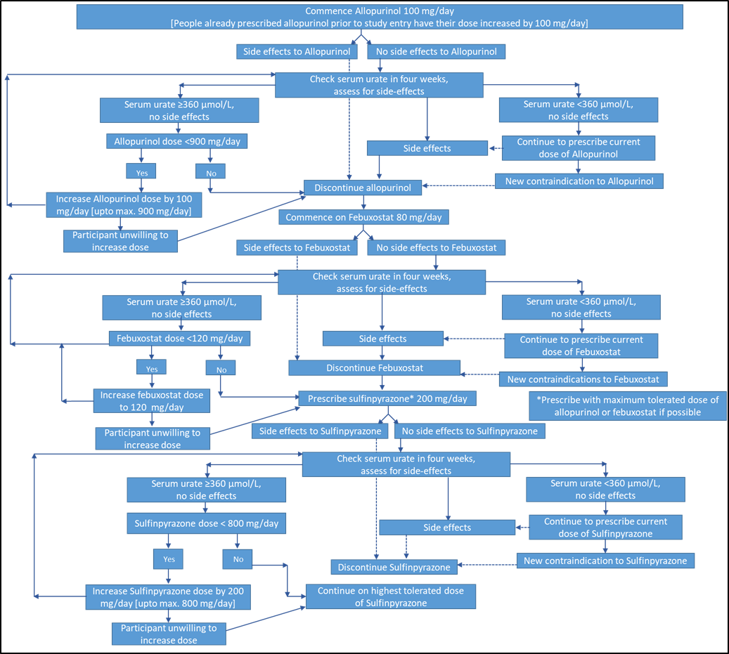
Treat to Target ULT arm – for information only

Slide 31
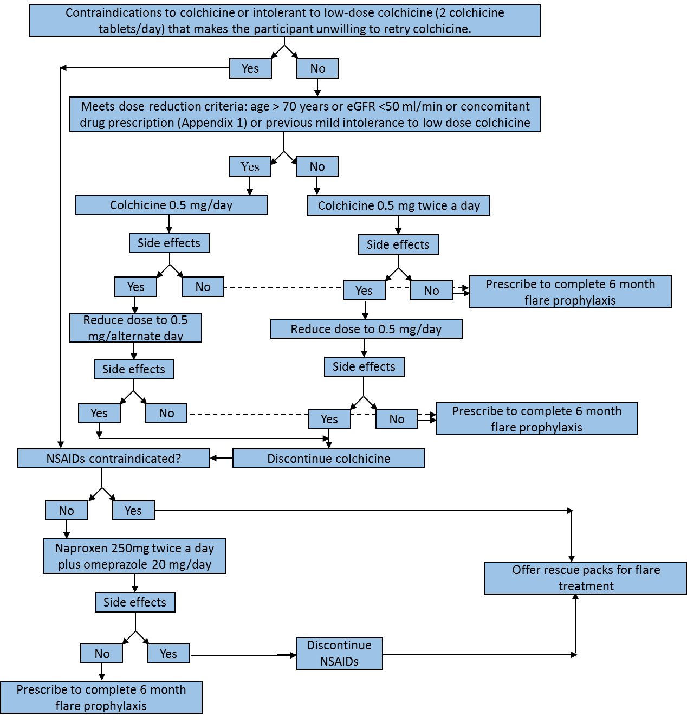
Treat to Target ULT arm – flare prophylaxis- for information only

Slide 32
Research visits at year 1 and year 2
The study team will record details of all patient scheduled visits at year 1 and year 2 and will contact the research nurse/researcher before this time to contact the patients to schedule these visits. Ask patient to return any unused medication packs and to bring along flare diaries not returned.
 | Res. Yr. 1 | Res. Yr. 2
Week | 52 | 104
Research questionnaires¹ | X | X
BMI, BP, tophus count/size | X | X
Blood collection | X^{2,3} | X^{2,3}
Urine collection | X⁵ | X⁵
Start T2T-ULT/dose change | X
Unused medication return | X | X
Flare & healthcare use diary collect | X | X

Slide 33

Research visits at year 1 and year 2
Same procedures as baseline.
Addition of pill count.
Any flares in last 12 months – that were not recorded in the diary or reported to the CTU by text or phone.
Blood collected for Serum urate.
Urine collection.
Collect any un-returned flare diaries.

Slide 34
Participant withdrawals and refusals
Participant may refuse to complete particular data collection point or to attend a particular research visit – classed as a refusal at that specific time point but will still be in the study.
Participant wishes to withdraw completely from the study no further contact made with patient – advise TM who will contact the patient to confirm withdrawal from the study.

Slide 35
Safety reporting
A SAE is any adverse event occurring following study mandated procedures, after receipt of the treatment or intervention that results in any of the following outcomes:
1. Death
2. A life-threatening adverse event
3. Inpatient hospitalization or prolongation of existing hospitalization
4. A disability / incapacity
5. A congenital anomaly in the offspring of a participant
If the participant informs of any of the above during the visit, please notify the study team immediately who will initiate the necessary paperwork.

Slide 36
Paperwork completion
All paperwork is scanned in to a database called TeleForm.
TeleForm is a highly intelligent data capture system designed to reduce data entry and manual processes associated with paper based forms projects.
Owing to this, all data must completed as neatly and accurately as possible and only completed in the spaces that are provided on the forms and questionnaires. – Participants must also be advised of this when completing questionnaires.
All dates should be recorded in the boxes provided in the format DD/MMM/YYYY (e.g 10 Jun 2019)
All boxes should be completed by marking an X in the relevant box and using black ink and capital letters where possible. Original copies of documentation should be sent back to Keele CTU.
Where any mistakes are made, please cross out the incorrect information, initial and date the error and update with correct information as close to boxes as possible. The verifier using teleform will be able to manually update corrected information.

Slide 37
Contact details
Emily Hughes – Trial Manager, Tel:01782 732950 email: e.hughes@keele.ac.uk
Stephanie Butler-Walley- Trial Manager, Tel: 01782 732950 email: s.butler1@keele.ac.uk
NHS.net email address: sch-tr.t2tgout@nhs.net

Slide 38
Thank you for listening.
Any questions?

